Slide 1

MoneyStream
Real-time currency exchange rates with partner-to-partner cash transfers

Slide 2
TABLE OF CONTENTS
01
04
02
05
03
06
OUR PRODUCT
BUSINESS PLAN
TEAM DESCRIPTION
MK& SALES STRATEGY
MARKET ANALYSIS
FINANCIAL PROJECTIONS

Slide 3
01
OUR PRODUCT

Slide 4
PROBLEM VS SOLUTION
PROBLEM
SOLUTION
Fragmented and Incoherent Information
Delayed Data Updates
Lack of Transparency
Insufficient cash
Complex and Difficult-to-Use Interfaces
Customizability
Real-Time Exchange Rates
Multi-Location Support
Cash Request & Delivery
Easy-to-Use UI

Slide 5
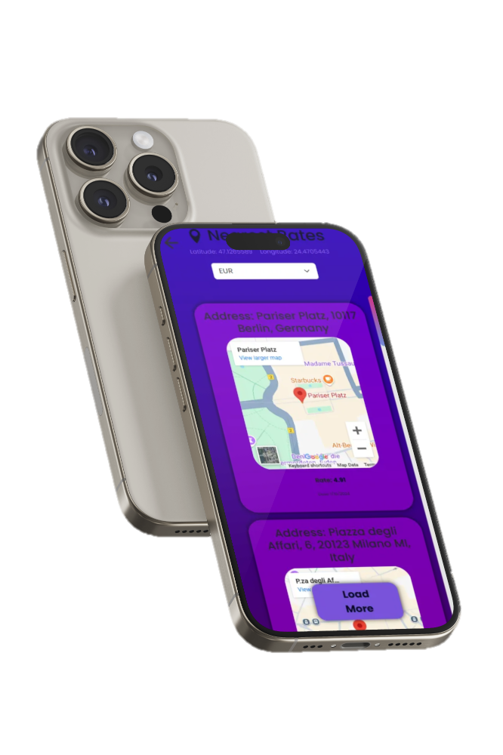
MONEYSTREAM
DESCRIPTION
PRICING STRATEGY
Financial platform that provides users with competitive real-time exchange rates and partners with fast cash transactions, and market trend monitoring tools. Monitor locations, currencies and exchange rates.
Tiered subscription model for partners based on the number of locations with FREE access to clients for a long-term growth.
DEVELOPMENT
CUSTOMER SUPPORT
Agile development approach, starting with an MVP built using Node.js, React.js, and MySQL. Three phase development (initial, beta, post-launch).
Support through live chat, email, and in-app assistance. Premium partners receive priority support for faster responses and personalized assistance.

Slide 6
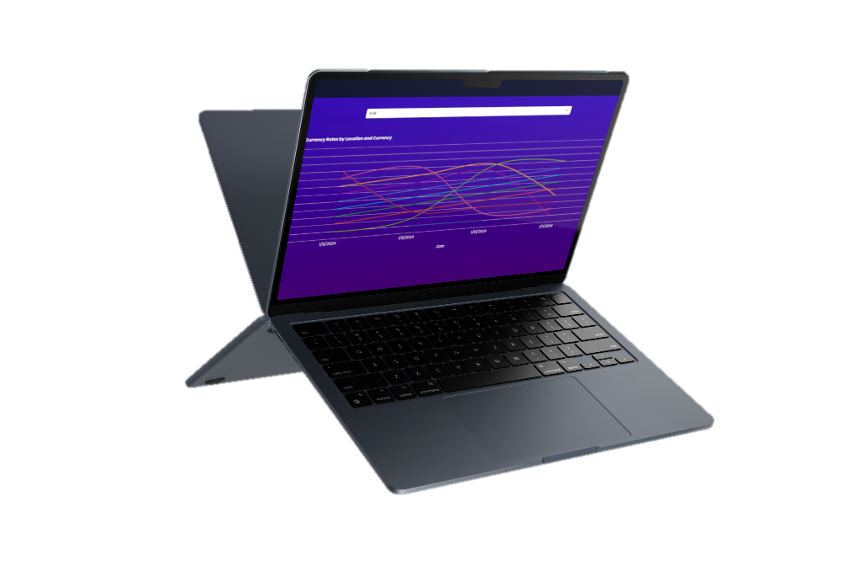
MOCKUP
Client platform.

Slide 7
MOCKUP
Partner platform.

Slide 8








KEY FEATURES
SECURE
CURRENCY MANAGEMENT
LOCATION MANAGEMENT
Unique Authentication for each partner on the platform.
Ability to add any currency including cryptocurrencies and other virtual currencies.
Manage multiple locations with Google Maps and geolocation integration.
CUSTOM RATES
PARTNER VISIBILITY
CLIENT FEATURES
Set rates based on location and currency.
View registered partners to facilitate communication and collaboration or request cash directly.
View the nearest, best, and all exchange services listed on the platform.

Slide 9
MODERN TECH STACK

Slide 10


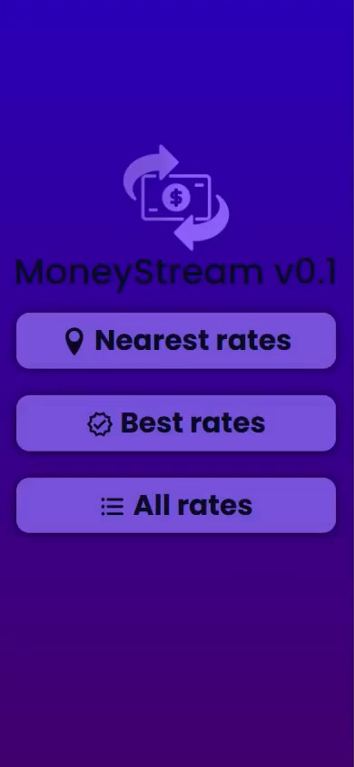
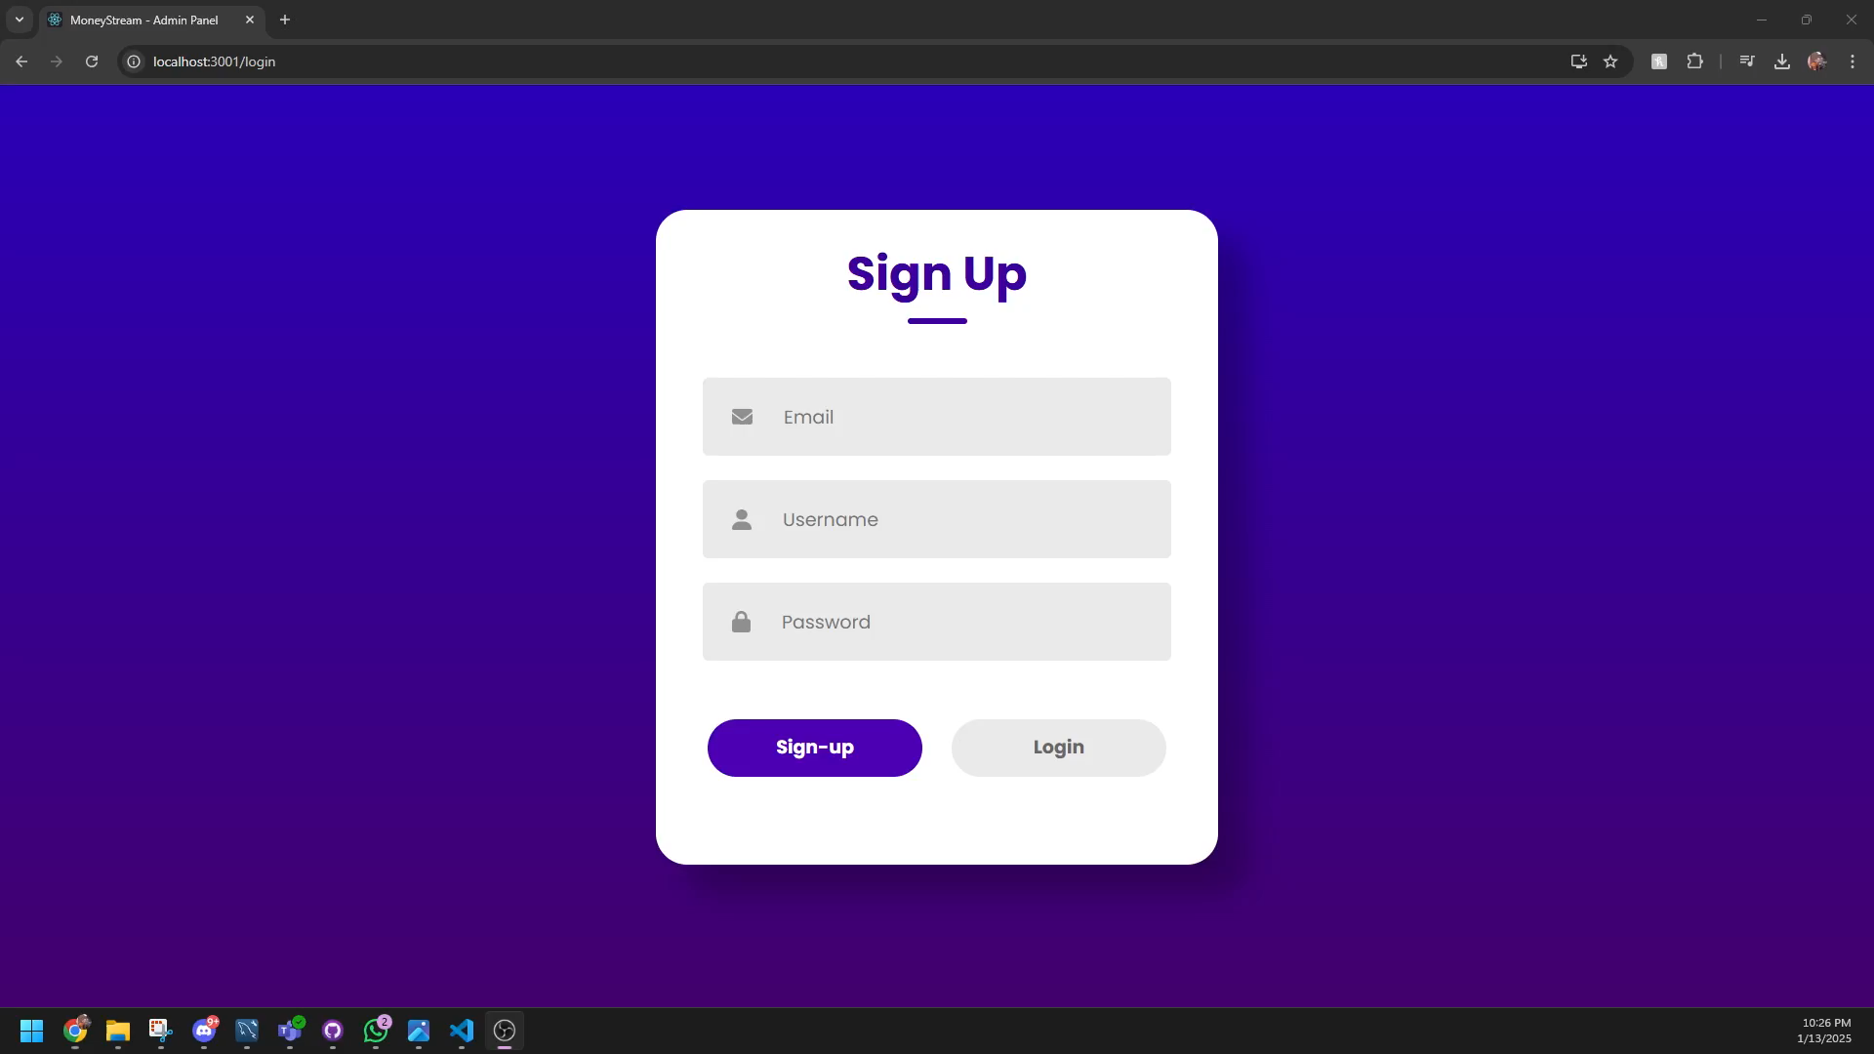
PLATFORM DEMO
02
TEAM DESCRIPTION

Slide 11
02
TEAM DESCRIPTION

Slide 12


MEET US
03
MARKET ANALYSIS
VISION
BARGAOANU BOGDAN
FORRAI DIANA
To create a seamless and transparent currency exchange platform that prioritizes both users and businesses by offering real-time rates, direct transactions, and powerful financial tools, ensuring efficiency, security, and mutual growth.
4th year Automation and Computer Science student.
Passionate about continuous learning and innovation.
Experience: Software Developer with 2 years experience @ PIM Software Transilvania, freelancing.
4th year Automation and Computer Science student.
Enthusiastic about connecting the physical and digital worlds.
Experience: Web Developer Intern @ CASE Software, Alumni FTC RO 005 Esentza Robotics, National Robotics Summer Camp Organizer.

Slide 13
03
MARKET ANALYSIS

Slide 14
MARKET ANALYSIS
INDUSTRY OVERVIEW
TARGET MARKET
COMPETITIVE LANDSCAPE
Our solution is part of the fast-growing fintech and digital currency exchange sector, driven by globalization and digital innovation. Mobile banking and real-time services fuel robust global growth.
Individual users such as travelers, expatriates, and freelancers seeking competitive exchange rates and commercial clients, including exchange bureaus and banks, in need of efficient, secure currency exchange solutions.
Our solution means to revolutionize exchange bureaus and competes with fintech platforms. Traditional services offer reliability with high fees and slow transactions, while competitors provide digital convenience but often lack cash-handling capabilities.
€150 M
€80 M
€50 M

Slide 15
MARKET SIZE INFOGRAPHIC
04
BUSINESS PLAN
€150 M
€150 M
The Romanian cash flow management market is part of a growing global trend, with a focus on SMEs, freelancers, and professionals.
€80 M
€80 M
The market for cash flow management tools in Romania is projected to grow to €80 million by 2030
€50 M
€50 M
The current market for cash flow management tools in Romania, as of 2025.

Slide 16
04
BUSINESS PLAN

Slide 17

EXECUTIVE SUMMARY
Our business plan outlines the strategy for MoneyStream, a fintech startup that provides real-time currency exchange, cash transactions, and market trend monitoring. Our mission is to streamline currency exchange by offering transparent rates, secure transactions, and direct partner negotiations.
The market analysis shows that there is a high demand for our services in the global financial and foreign exchange industry. We have identified key competitors, including traditional exchange bureaus and digital currency platforms, and believe we can differentiate ourselves through our unique selling propositions (USPs):

Slide 18
UNIQUE SELLING PROPOSITIONS
REAL-TIME RATES
REQUEST AND DELIVERY
Users can instantly compare exchange rates from multiple partners and locate the best deals via an interactive map.
Businesses can request cash from platform-enrolled partners, ensuring fast, secure, and efficient cash flow management.
MULTI-LOCATION
DATA VISUALIZATION
Partners can register multiple business locations, allowing them to manage exchange services across different areas seamlessly.
Partners enrolled gain access to real-time analytics through interactive charts and dashboards.

Slide 19
CANVAS INFOGRAPHIC
KEY PARTNERS | KEY ACTIVITIES | VALUE PROPOSITIONS |  | CUSTOMER RELATIONSHIPS | CUSTOMER SEGMENTS
Exchange Bureaus | Competitive exchange rates and P2P cash delivery system | Multi-location integration eliminating need for intermediaries for faster, more cost effective transactions |  | In-app support, live chat, email assistance, personalized notifications | Businesses and tech-savvy individuals
 | KEY RESOURCES |  |  | CHANNELS
 | Skilled development team, support team and funding |  |  | Social media ads, SEO, email campaigns
COST STRUCTURE |  |  | REVENUE STREAMS
Platform development budget, marketing budget, customer support budget |  |  | Tiered Partner Subscriptions

Slide 20
BUSINESS STRATEGY
Attractive business model
GROWTH AND EXPANSION STRATEGY
REORIENTATION OR ABANDONMENT STRATEGY
High competitive strength
Low competitive strength
MAINTENANCE AND PROTECTION STRATEGY
REDUCTION OR ELIMINATION STRATEGY
Unattractive business model

Slide 21
SELLING PLAN (1ST YEAR)
1ST QUARTER
2ND QUARTER
Beta launch, onboarding strategic partners (exchange offices, hotels, airports).
Digital marketing campaign (SEO, social media, Google Ads), customer onboarding.
3RD QUARTER
4TH QUARTER
Expansion of partnerships in key cities, feature optimization based on feedback.
Full-scale launch, integration with third-party financial applications, monetization through commissions and premium subscriptions.

Slide 22
BUSINESS PLAN TIMELINE
MK & SALES STRATEGY
01
Research and planning
06
Scaling phase
07
Innovation phase
02
Start-up phase
05
Product expansion
08
Exit strategy planning
03
Growth phase
04
Partnership
09
Final phase

Slide 23
05
MK & SALES STRATEGY

Slide 24
MARKETING & SALES STRATEGY
TARGET MARKET
VALUE PROPOSITION
MK CHANNELS
Tech-savvy individuals (18-55) needing fast, secure currency exchanges and businesses managing multi-location operations.
P2P cash delivery alongside real-time rate comparisons bypassing intermediaries and offering faster, more secure, and cost-effective currency exchanges.
Social media, email marketing, SEO/SEM, and online ads. A personalized options will capture customer preferences to tailor our product and offers.
SALES PROCESS
COMPETITIVE ANALYSIS
METRICS AND GOALS
Leads via ads, freemium trials, demos , case studies and emails. Tiered pricing and risk-free onboarding for partners. Retention and expansion through reviews, campaigns and community building.
Our solution stands out with direct P2P cash delivery, real-time rates, and multi-location management for businesses while the competition relies on intermediaries.
Engagement: 2.500+ users monthly
Transaction Volume: 5M+
Partner Onboarding: 50+
Conversion Rate: 1.5-2% advantage
Customer Retention: 65%

Slide 25
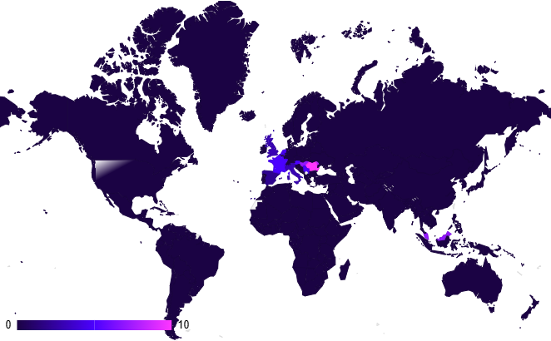
PARTNER GROWTH, CLIENT VALUE
AGE
GENDER
PARTNER
USER
OCCUPATION
TIERED SUBSCRIPTIONS pricing based on number of locations (€50/month for 1–5 locations), scaling with volume discounts and premium perks like API access (up to €500/month for 10+ locations).
FREE access to core features (finding closest and best rates for all the enrolled partners).
FAMILY SITUATION
25%
75%
INCOME
REGION
AREA

Slide 26
TARGET INFOGRAPHIC
FINANCIAL PROJECTIONS
06
DEMOGRAPHIC
LOCATIONS
BEHAVIOR
AGE
18-55 years old
The increasing passive user community will generate active buyers (partners) through the freemium model with focus on scaling.
GENDER
Male and female
OCCUPATION
Employees
and students
5%
95%
FAMILY SITUATION
Single and married people
REGION
Various
INCOME
$20,000+/year
AREA
Urban
PARTNERS
USERS

Slide 27
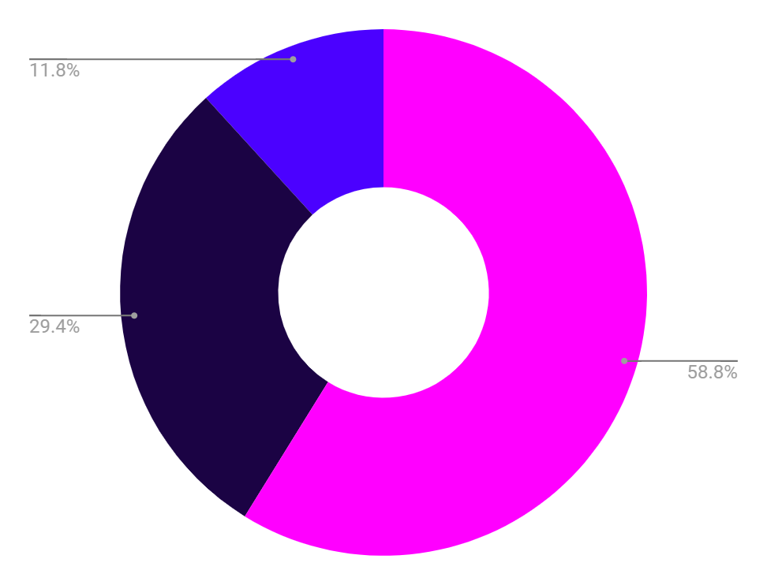
06
FINANCIAL PROJECTIONS

Slide 28
BUDGET FOR INITIAL LAUNCH (MVP)
€50,000
€25,000
€10,000
Product development
Marketing
Support

Slide 29
REVENUE INFORMATION
 | Q1 | Q2 | Q3 | Q4 | TOTAL
PRODUCT SALES | $25,000 | $35,000 | $40,000 | $60,000 | $160,000
SALARIES | $11,000 | $11,000 | $12,000 | $12,000 | $46,000
SUPPORT | $2,500 | $2,500 | $2,500 | $2,500 | $10,000
MARKETING | $7,000 | $6,000 | $6,000 | $6,000 | $25,000
NET INCOME | $3,500 | $14,500 | $18,500 | $38,500 | $75,000
UTILITIES | $1,000 | $1,000 | $1,000 | $1,000 | $4,000

Slide 30

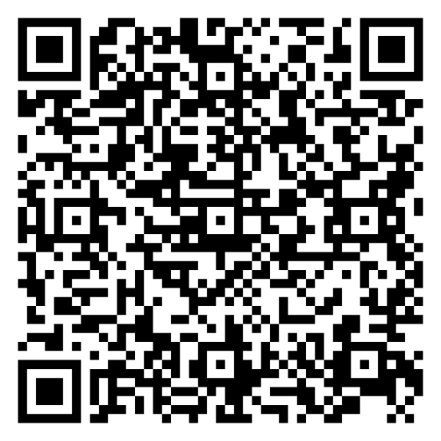
ORGANIZATIONAL CHART(after succesful platform launch)
DIRECTOR OF HR
SYSTEM ADMINISTRATOR
CTO
DIRECTOR OF IT
IT MANAGER
CEO
ACCOUNTING MANAGER
CONTROLLER
FINANCIAL ANALYST
CFO
TREASURER
ACCOUNTS PAYABLE

Slide 31
YOU OPINION MATTERS
THANKS!
We invite you to complete this questionnaire, whether you are an interested client or a potential partner, to contribute to the development of our project and become part of the MoneyStream journey!

Slide 32
THANKS!
Do you have any questions?
bargaoanubogdan19@gmail.com
+40 745 507 155 diana.forrai12@yahoo.com

